Slide 1
Will a movie become blockbuster?
See what audiences say
Jiaming Liu, Johnny Chen, Jungbeom Lee,
Mengjin Sun, Yi Yu, Yuanzheng Chang
- April 2016 -

Slide 2

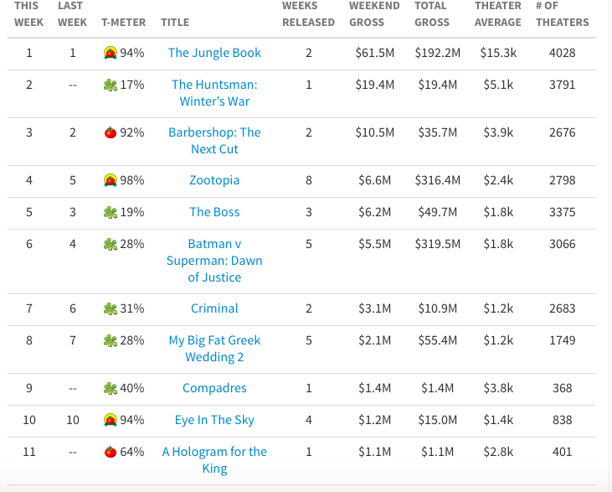

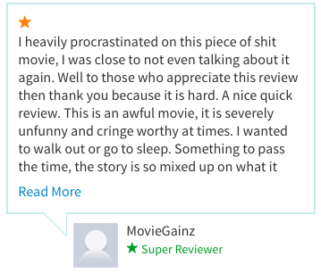

Box Office vs. Audience Comments
Our mission is predicting movie sales based on the feedback from audience
Comments
Box Officec
POSITIVE
NEGATIVE

Slide 3
Approach: Sentiment Analysis
Performed sentiment analysis based on movie reviews scrapped from wed pages
Web Scraping
Prediction modeling
Visualization
Sentiment Analysis
Database
Our Focus:
Grabbed audience reviews, budges and sales of more than 100 movies from …..
Construct MySQL database for data store and query
Used ... Python package to conduct sentiment analysis based on reviews, outputing scores
Predict sales based on sentiment scores
Created a webpage to visualize results from sentiment analysis and predictions

Slide 4
Web Scraping
Assumptions | Movies with budgets higher than $40 MM. Actors and Directors that have received nominations and have the highest gross revenue. Focused on movies produced in the U.S.

Slide 5
Database
Assumptions | Movies with budgets higher than $40 MM. Actors and Directors that have received nominations and have the highest gross revenue. Focused on movies produced in the U.S.

Slide 6
Sentiment Analysis
Assumptions | Movies with budgets higher than $40 MM. Actors and Directors that have received nominations and have the highest gross revenue. Focused on movies produced in the U.S.

Slide 7
Prediction Model
Assumptions | Movies with budgets higher than $40 MM. Actors and Directors that have received nominations and have the highest gross revenue. Focused on movies produced in the U.S.

Slide 8
Results visualization
Packages used:
Flask – Python web development framework
Highcharts – data visualization in charts
Datatabels – data visualization in tables
jQuery – dynamic content management
Bootstrap – web page construction
Assumptions | Movies with budgets higher than $40 MM. Actors and Directors that have received nominations and have the highest gross revenue. Focused on movies produced in the U.S.

Slide 9
Conclusion
Assumptions | Movies with budgets higher than $40 MM. Actors and Directors that have received nominations and have the highest gross revenue. Focused on movies produced in the U.S.

